Slide 1
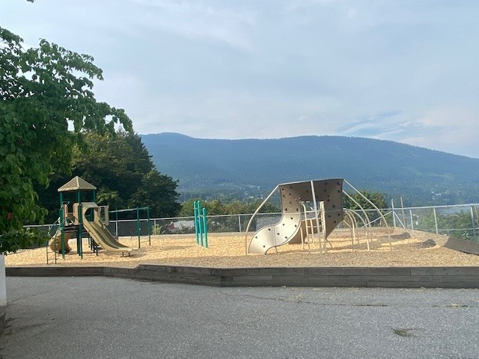

South Nelson Elementary School
Principal PAC Report
February 2026

Slide 2
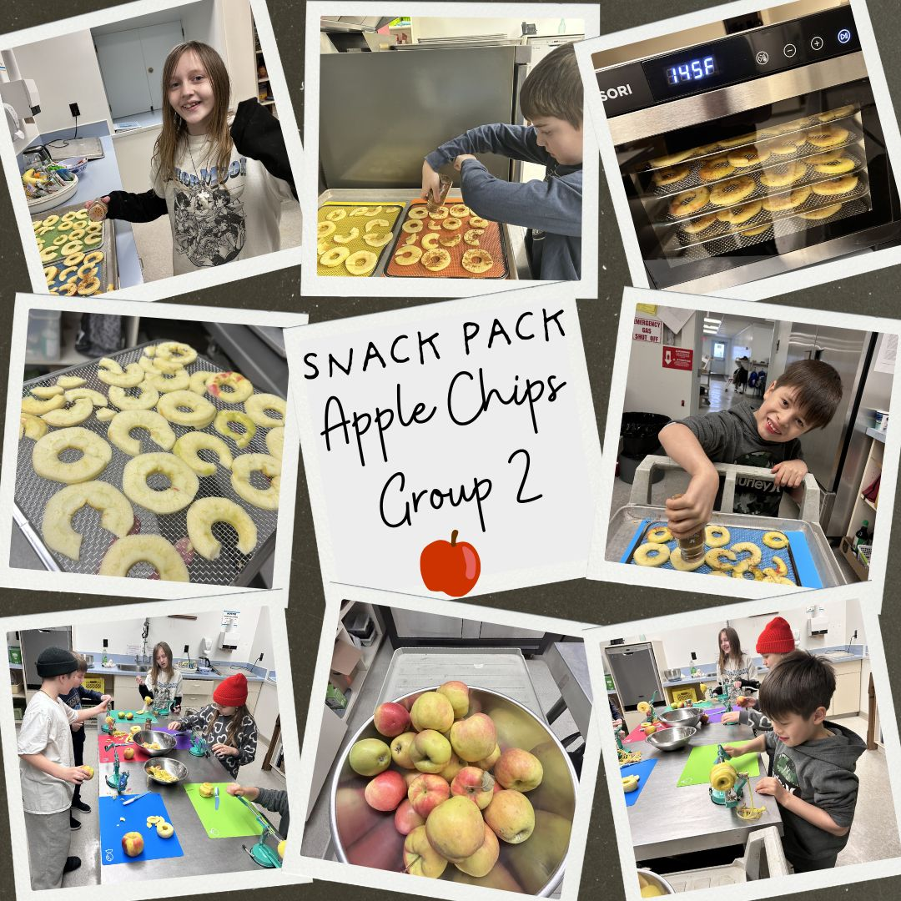
Highlights
Winter activities began (WH20, XC)
Play in the K
Healthy Snack club
Black Excellence Day
Volleyball
Research projects
Check frequently for news:
https://southnelson.sd8.bc.ca/

Slide 3
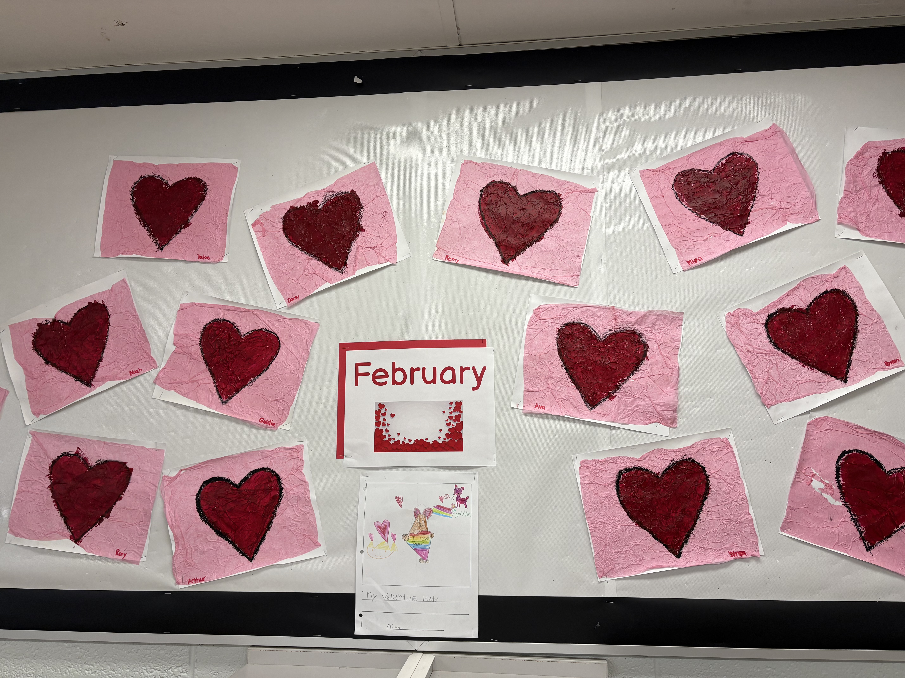
Looking forward and coming up…
Valentine’s Day
Black History Month
Winter activities continuing (XC/Downhill)
Play in the K (March 4)
Pink Shirt Day (Feb. 25
Cardboard Arcade (March 12)
Swimming lessons (update)

Slide 4
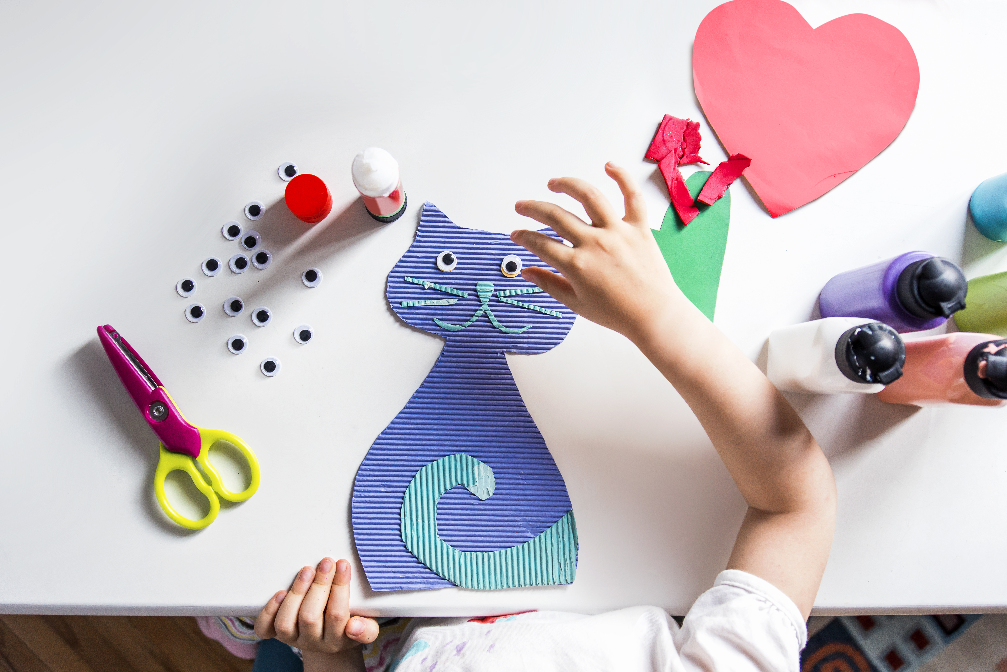

How you can Partner with us..
Craft club $265-300
April 22/23
Author visit $250

Slide 5
Questions?

