Slide 1
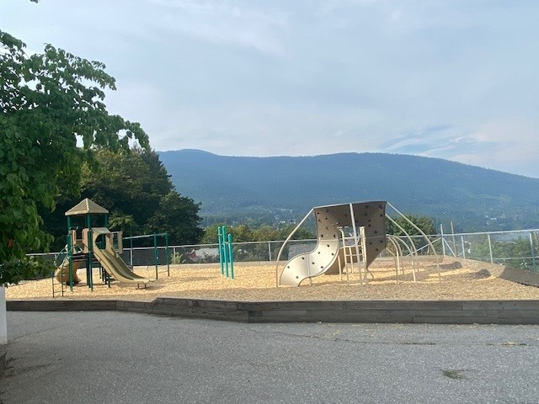

South Nelson Elementary School
Principal PAC Report
September 2025

Slide 2
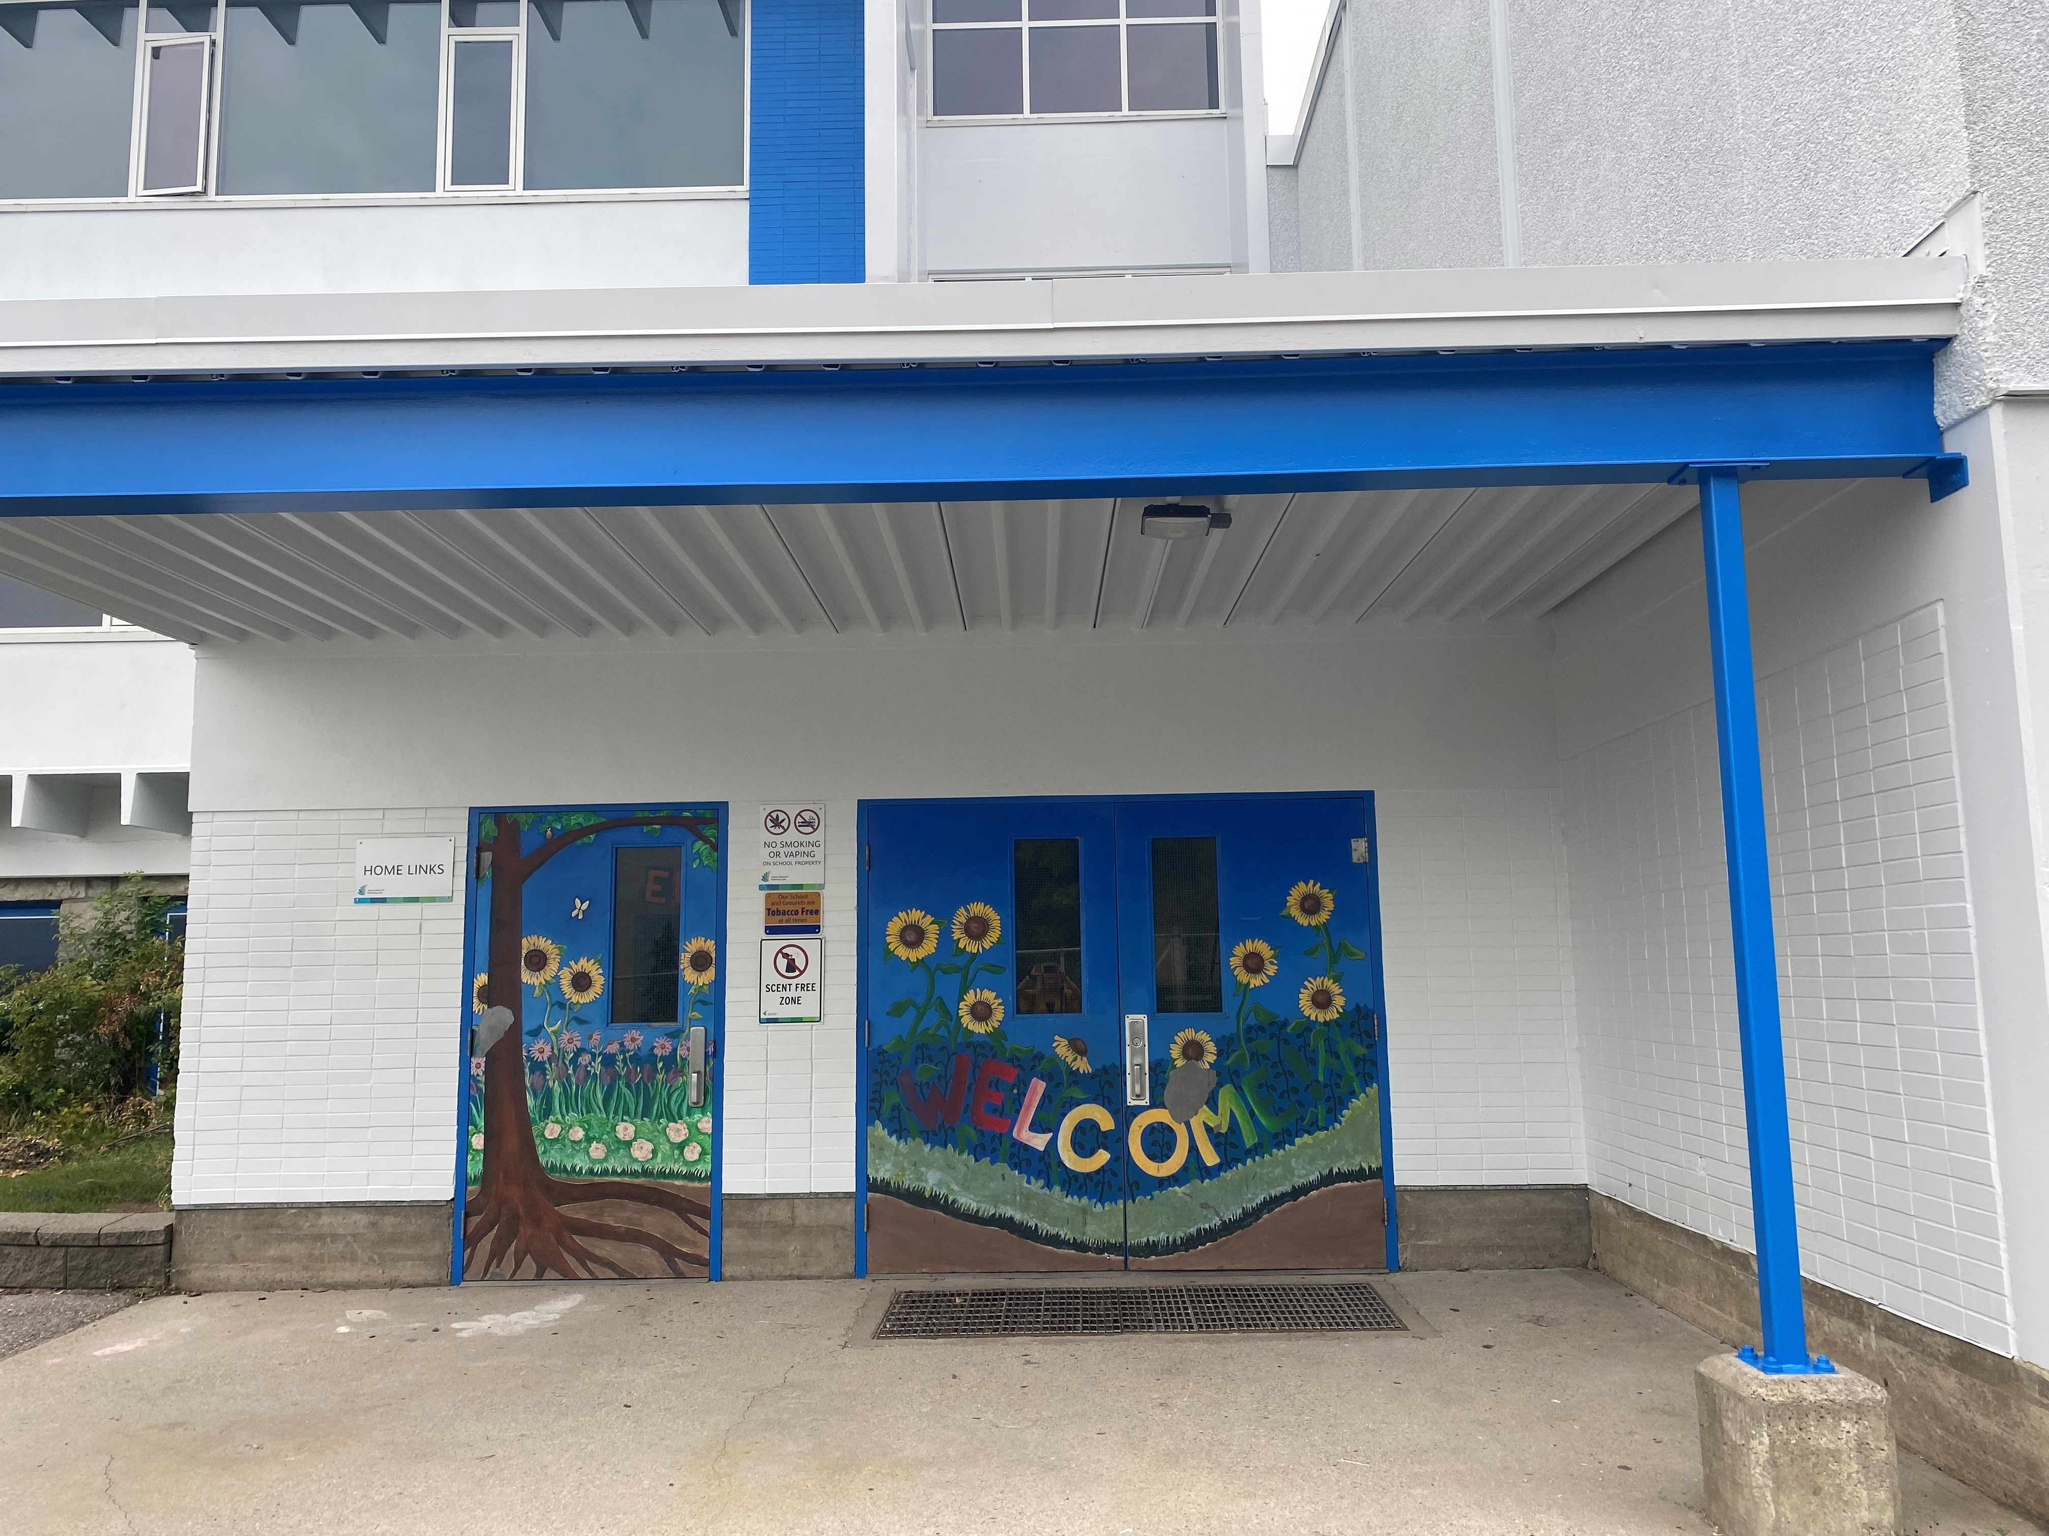
Welcome to the 2025-26 School Year!
Introduction
Welcome to new families
School Enrolment
Check frequently for news:
https://southnelson.sd8.bc.ca/

Slide 3
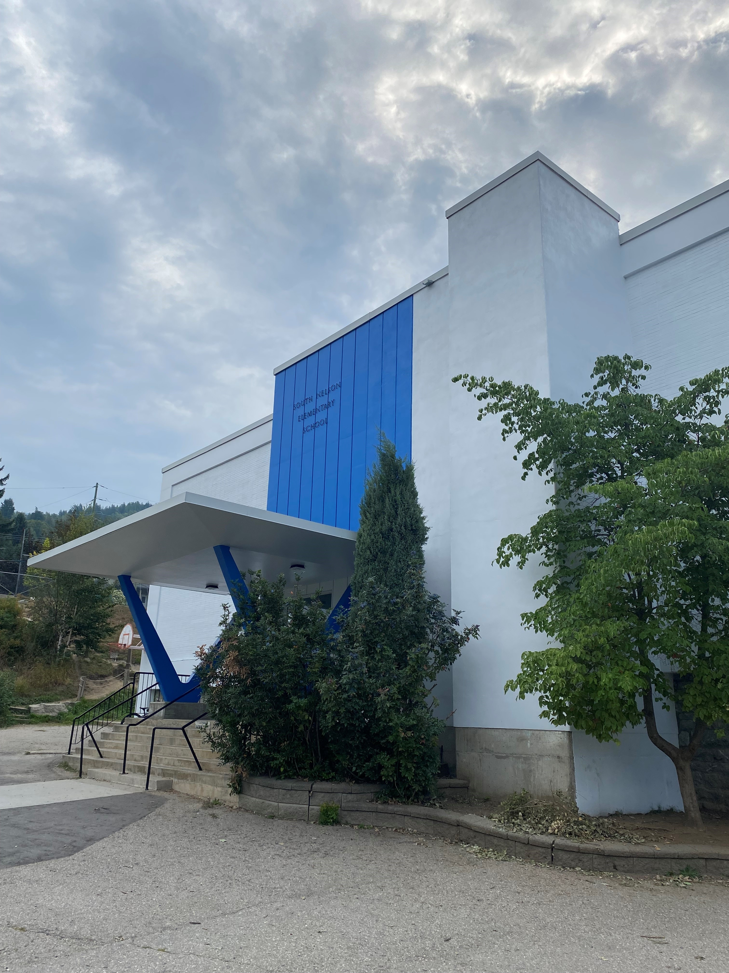
Our Teaching Team
Primary Team
Gr. K/1 - Mrs. Dimopoulos
Mrs. Leeming
Gr. ½ - Mrs. Lehnert
Gr. 2/3 - Mrs. Crosland/
Mrs. BenRabha
Intermediate Team
Gr. ¾ - Mrs. Bonikowsky
Mr. Marsh
Gr. ⅘ - Mrs. Sparks
Gr. 5/6 - Mrs. DeSousa

Slide 4

Our Support Teachers
Library – Mrs. Stewart
Music - Ms. Ward
ADST Prep – Mrs. Wilson
Indigenous Success Teacher - Ms. Corner
Counselling - Ms. Stewart
Inclusion Support - Ms. Douglas

Slide 5

Our Support Team
Educational Assistants
Jessica Benson
John Ryan
Dana Gallagher
Bernice Beaudin
Eden Martin
Clerical/Custodial
Laura Lundy - Secretary
Lola Matulin - Custodial

Slide 6
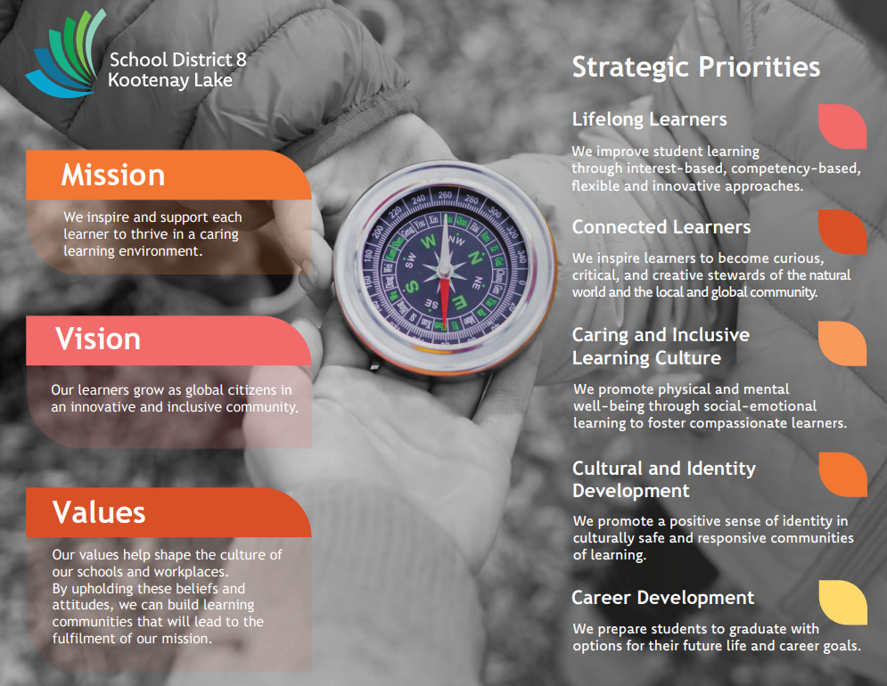
Strategic Plan

Slide 7

Our Code of Conduct

Slide 8
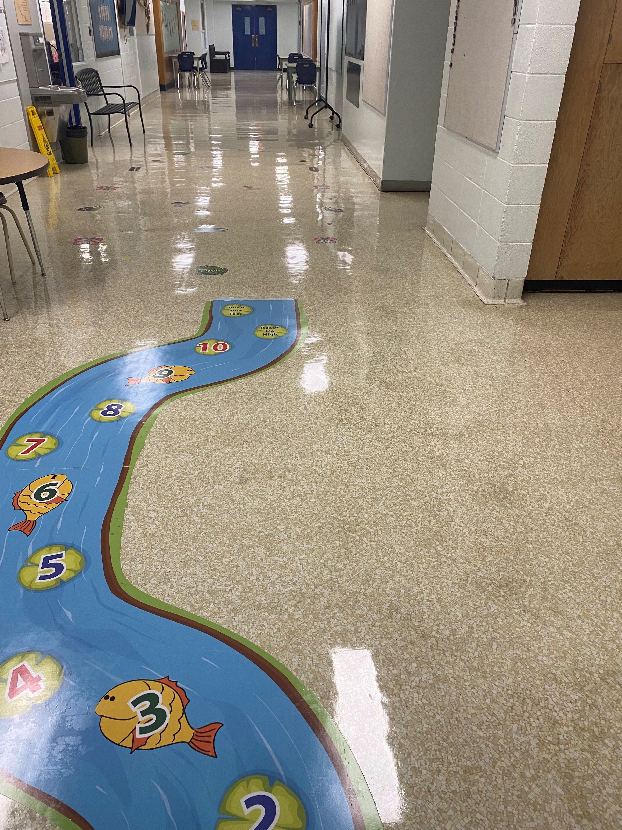
Highlights
New Students
Building Classroom Communities
Gradual Kindergarten Entry
Cross Country Running
Student Council

Slide 9
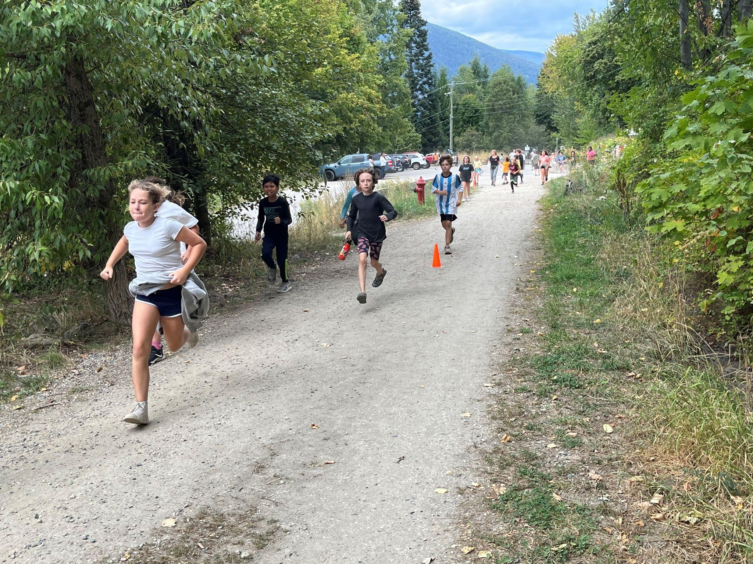
Looking forward and coming up…
Kokanee Field Trips
School Planning Day (Sept. 19)
Terry Fox Run (Sept. 26)
Orange Shirt Day (Sept. 29) - National Day for Truth and Reconciliation Assembly
October Safety Preparedness Month

Slide 10

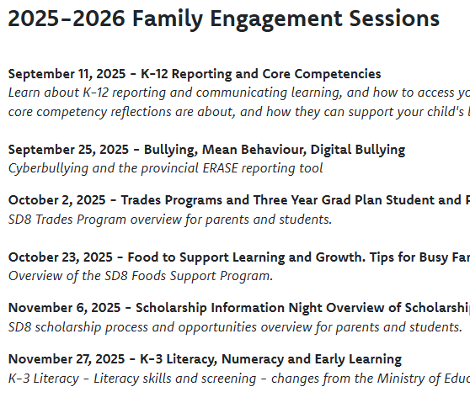
SD 8 Family Engagement Webinars

Slide 11

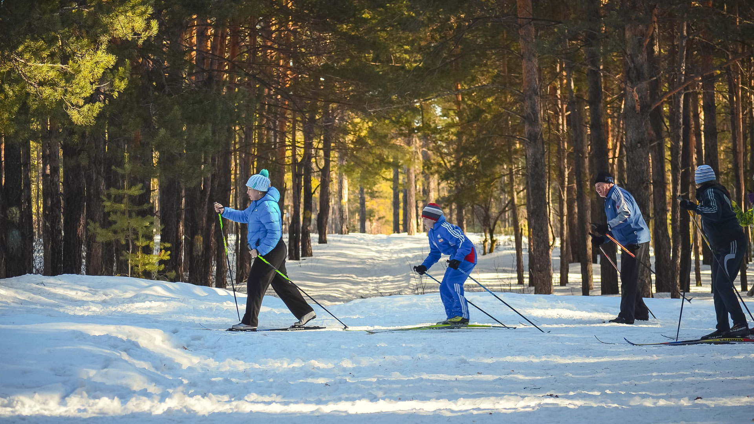
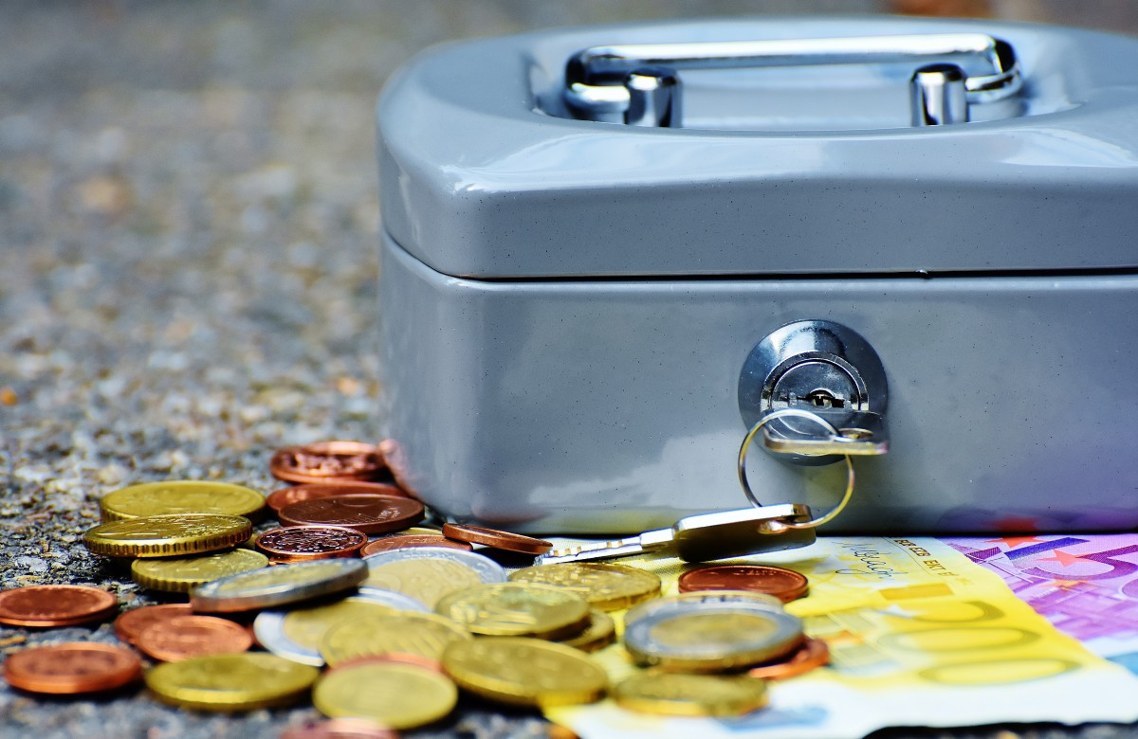
How you can Partner with us..

Slide 12
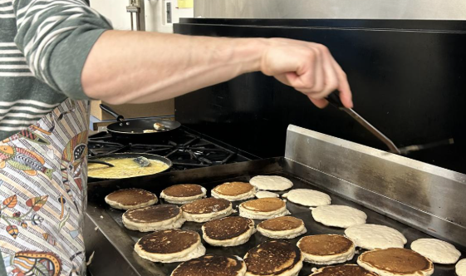
Food Equity Program

Slide 13



Slide 14
Questions?

